Slide 1

Few-Shot Visual Relationship Co-Localization
Revant Teotia*, Vaibhav Mishra*, Mayank Maheshwari*, and Anand Mishra
IIT Jodhpur
(*: Equally contributed)

Slide 2
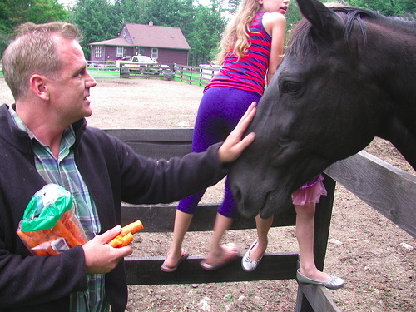

Images are not just collection of objects

Slide 3
Visual Relationship
= <Subject, Predicate, Object>

Slide 4
Visual Relationship
= <Subject, Predicate, Object>

Slide 5
Visual Relationship
= <Subject, Predicate, Object>
Petting

Slide 6
Visual Relationship
= <Subject, Predicate, Object>

Slide 7
Visual Relationship
= <Subject, Predicate, Object>
Riding

Slide 8
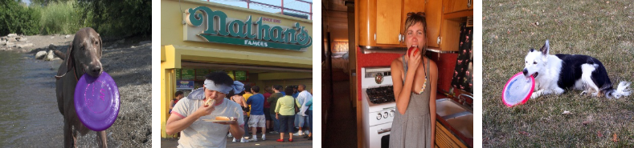
Can you localize common visual relationships?

Slide 9
Visual Relationship Co-Localization : This work

Slide 10
Problem Statement
Given a bag of b images each containing a common hidden predicate, localize visual subject and object connected via the common predicate in each of the b images.

Slide 11
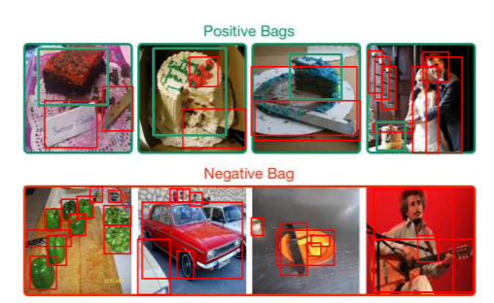
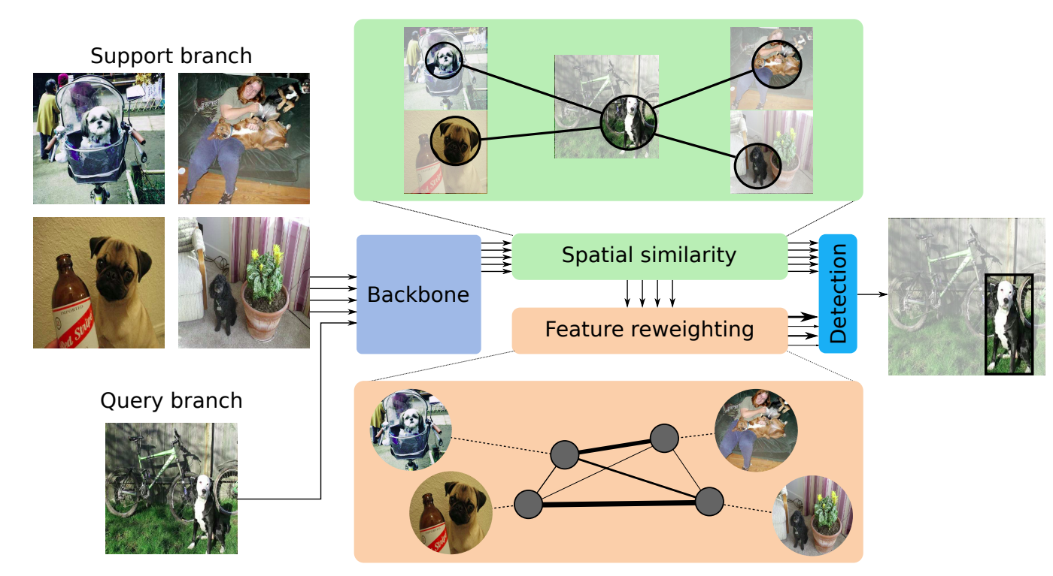
Object Co-Localization and WSOL
[Shaban et al., ICCV 2019]
[Hu et al., ICCV 2019]

Slide 12
VRC as a Labeling Problem

Slide 13
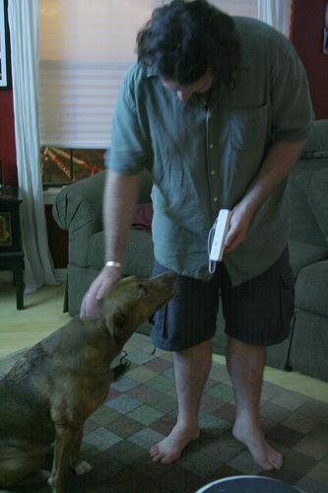
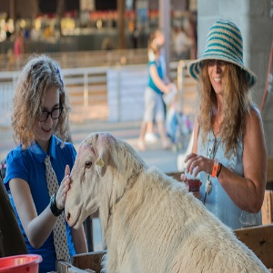
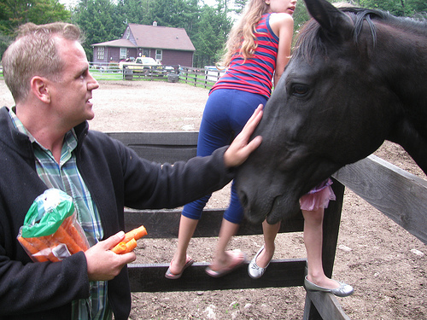
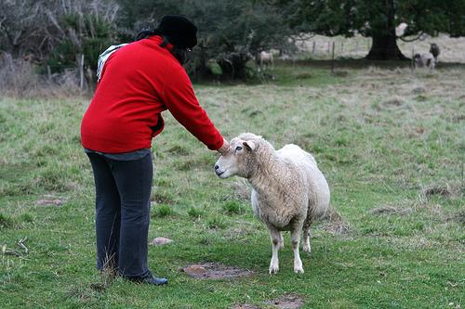
Given a bag of images
Image-2
Image-4
Image-1
Image-3

Slide 14
Construct a fully connected graph
Image-2
Image-4
Image-1
Image-3

Slide 15
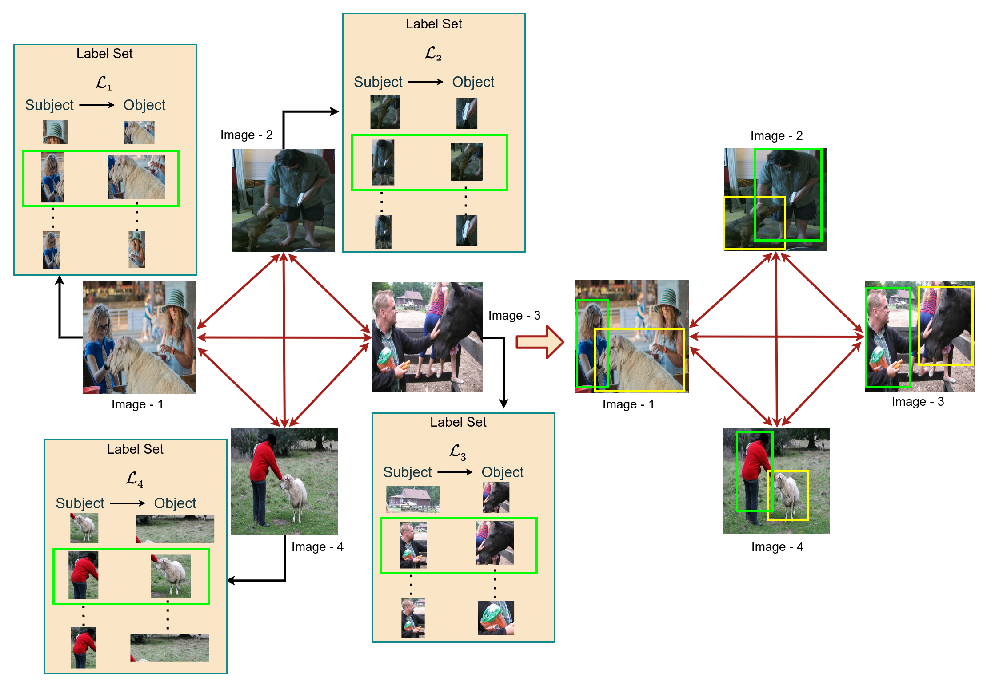
Label set = all possible visual relationships
Image-2
Image-4
Image-1
Image-3

Slide 16
How to get the label set for an image?

Slide 17
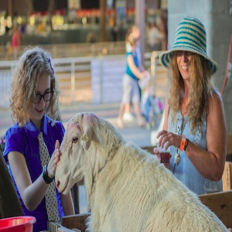




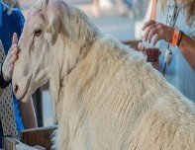

Label set generation
subject
object
l₁
Faster R-CNN
l₂
l₃
… …
Given image
Detected visual objects
Label set ℒ
Label set = all possible visual relationships in an image
= all possible ordered pairs of detected visual objects in an image

Slide 18
How to get the optimal labeling?

Slide 19
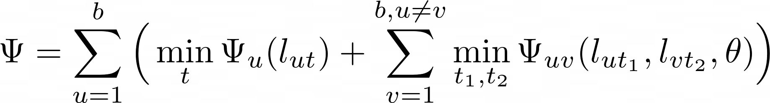

Slide 20
Sum over all the b images

Slide 21


Unary cost of assigning a label to image- .
Considered uniform, does not contribute

Slide 22
Pairwise cost of assigning labels
l_{ut1} to image u and l_{vt2} to image v.
Lower when predicates of l_{ut1} and l_{vt2} are semantically similar

Slide 23
How to compute pairwise cost?

Slide 24
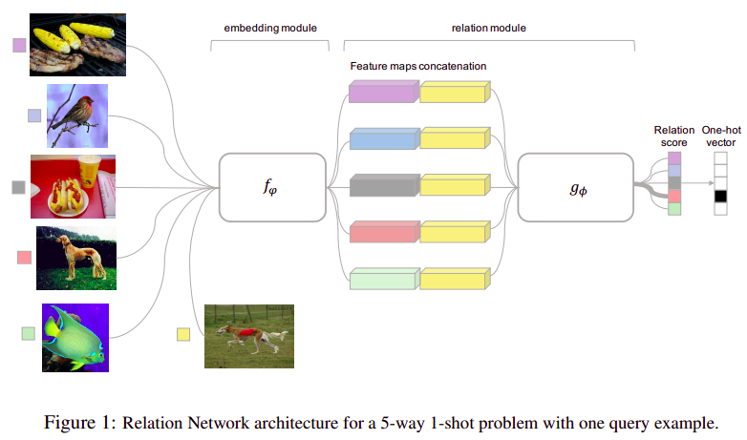
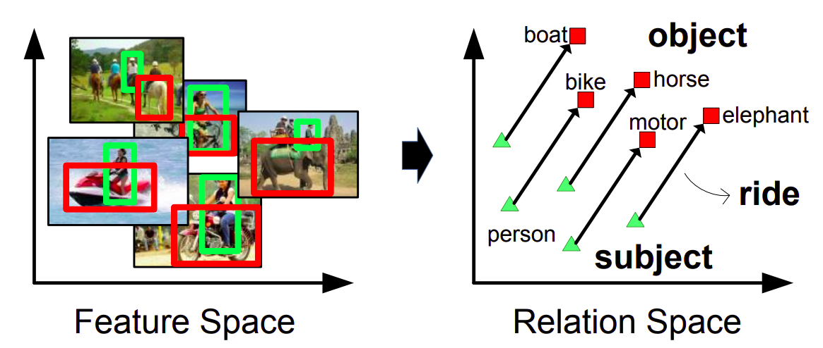
VTransE + Relation Network to learn VR similarity
VTransE
Relation Network
[ Zhang et al., CVPR 2017]
[Sung et al., CVPR 2018]

Slide 25
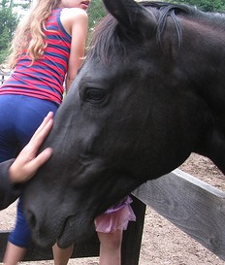

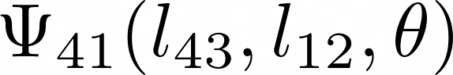
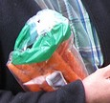
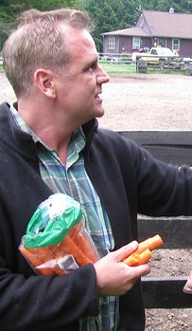
Pairwise Cost = - VR Similarity
Pairwise cost
l₄₁
= -R_{𝞡}(f₄₃, f₁₂)
l₄₂
VTransE
f₄₃
l₄₃
ℒ₄
Relation Network
R_{𝞡}(f₄₃, f₁₂)
l₁₁
Similarity Score b/w VR l₄₃ and l₁₂
l₁₂
VTransE
f₁₂
l₁₃
Similar VRs → low pairwise cost
Dissimilar VRs → high pairwise cost
ℒ₁

Slide 26
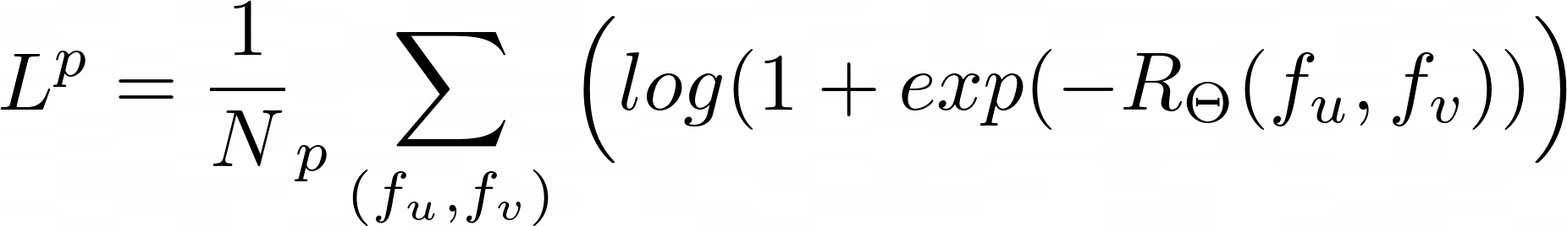
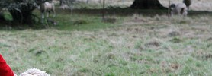
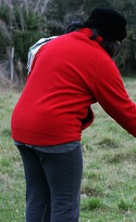
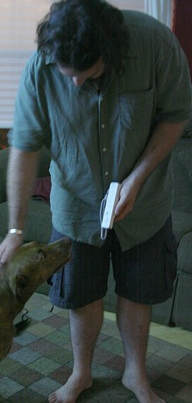
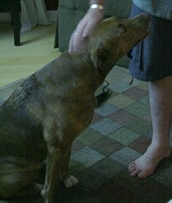

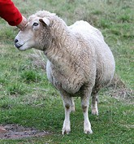
Episodic training with binary logistic regression loss
For positive pairs:
Positive pairs = pair of labels / VRs sharing common predicate.
e.g. (l₂₂, l₄₃) : l₂₂ = <woman, petting, sheep> and l₄₃ = <man, petting, horse>
Label sets of images in the bag
l₁₁
l₂₁
l₃₁
l₄₁
l₁₂
l₂₂
l₃₂
l₄₂
l₁₃
l₂₃
l₃₃
l₄₃
ℒ₁
ℒ₂
ℒ₃
ℒ₄

Slide 27
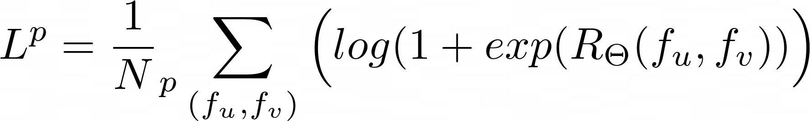
Episodic training with binary logistic regression loss
For negative pairs:
Negative pairs = pair of labels / VRs having different predicate.
e.g. (l₁₁, l₄₃) : l₂₂ = <woman, wearing, hat> and l₄₃ = <man, petting, horse>
Label sets of images in the bag
l₁₁
l₂₁
l₃₁
l₄₁
l₁₂
l₂₂
l₃₂
l₄₂
l₁₃
l₂₃
l₃₃
l₄₃
ℒ₁
ℒ₂
ℒ₃
ℒ₄

Slide 28
Inference stage

Slide 29
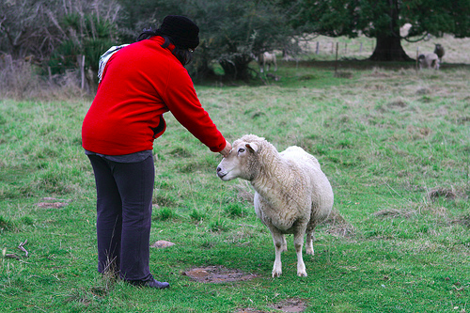
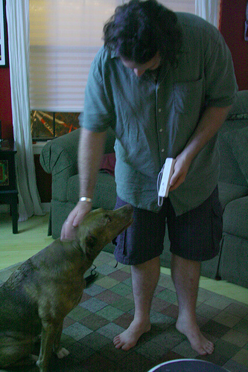
Inference
ɭ₁₁
ɭ₂₁
ɭ₃₁
ɭ₄₁
ɭ₁₂
ɭ₂₂
ɭ₃₂
ɭ₄₂
ɭ₁₃
ɭ₂₃
ɭ₃₃
ɭ₄₃
image-1
image-2
image-3
image-4

Slide 30
Inference
Potential labeling
sorted according to cost
Leaf
nodes
(ɭ₁₂, ɭ₂₂), (ɭ₁₁, ɭ₂₃), (ɭ₁₃, ɭ₂₁), (ɭ₁₂, ɭ₂₁), ...
(ɭ₃₁, ɭ₄₃), (ɭ₃₃, ɭ₄₃), (ɭ₃₂, ɭ₄₂), (ɭ₃₁, ɭ₄₂), ...
ɭ₁₁
ɭ₂₁
ɭ₃₁
ɭ₄₁
ɭ₁₂
ɭ₂₂
ɭ₃₂
ɭ₄₂
ɭ₁₃
ɭ₂₃
ɭ₃₃
ɭ₄₃
image-1
image-2
image-3
image-4

Slide 31
Inference
bestK
bestK
Leaf
nodes
(ɭ₁₂, ɭ₂₂), (ɭ₁₁, ɭ₂₃), (ɭ₁₃, ɭ₂₁), (ɭ₁₂, ɭ₂₁), ...
(ɭ₃₁, ɭ₄₃), (ɭ₃₃, ɭ₄₃), (ɭ₃₂, ɭ₄₂), (ɭ₃₁, ɭ₄₂), ...
ɭ₁₁
ɭ₂₁
ɭ₃₁
ɭ₄₁
ɭ₁₂
ɭ₂₂
ɭ₃₂
ɭ₄₂
ɭ₁₃
ɭ₂₃
ɭ₃₃
ɭ₄₃
image-1
image-2
image-3
image-4

Slide 32
Inference
Final prediction for whole bag
Potential labeling sorted according to cost
Root node
(ɭ₁₂, ɭ₂₂, ɭ₃₁, ɭ₄₃), (ɭ₁₂, ɭ₂₂, ɭ₃₃, ɭ₄₃), (ɭ₁₁, ɭ₂₃, ɭ₃₁, ɭ₄₃), …
bestK
bestK
Leaf
nodes
(ɭ₁₂, ɭ₂₂), (ɭ₁₁, ɭ₂₃), (ɭ₁₃, ɭ₂₁), (ɭ₁₂, ɭ₂₁), ...
(ɭ₃₁, ɭ₄₃), (ɭ₃₃, ɭ₄₃), (ɭ₃₂, ɭ₄₂), (ɭ₃₁, ɭ₄₂), ...
ɭ₁₁
ɭ₂₁
ɭ₃₁
ɭ₄₁
ɭ₁₂
ɭ₂₂
ɭ₃₂
ɭ₄₂
ɭ₁₃
ɭ₂₃
ɭ₃₃
ɭ₄₃
image-1
image-2
image-3
image-4

Slide 33
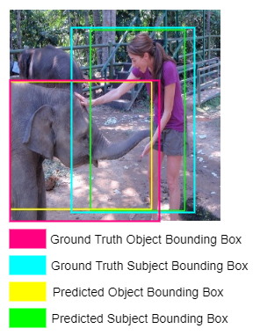
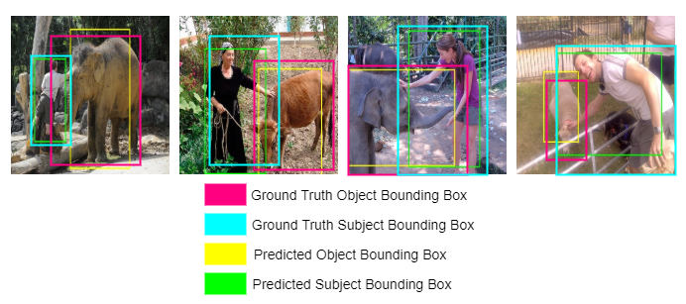
Performance Measure: VR Corloc and Bag Corloc
VR-CorLoc
Bag CorLoc
fraction of test images for which visual subject-object pairs are correctly localized.
fraction of the total number of bags for which the visual subject-object pairs are correctly localized for all of its images.

Slide 34
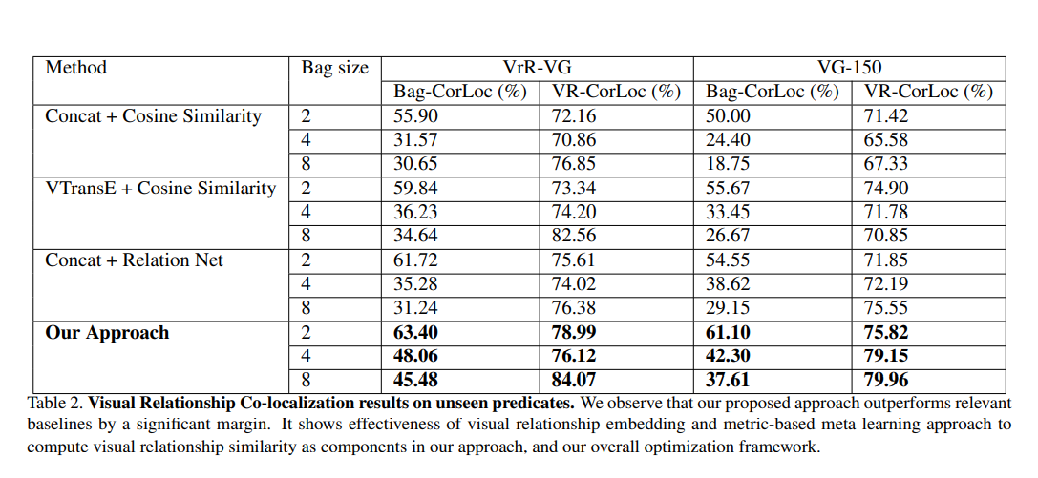
Quantitative Results

Slide 35
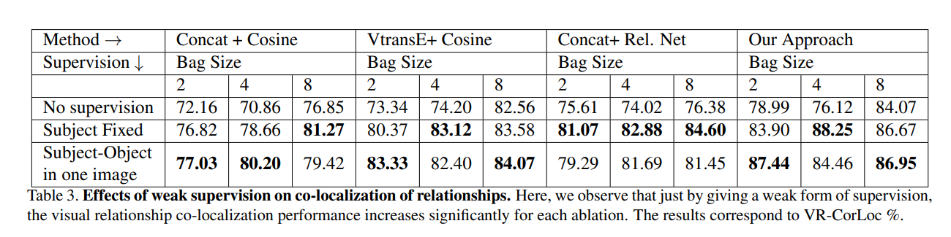
Quantitative Results

Slide 36
Qualitative Results

Slide 37
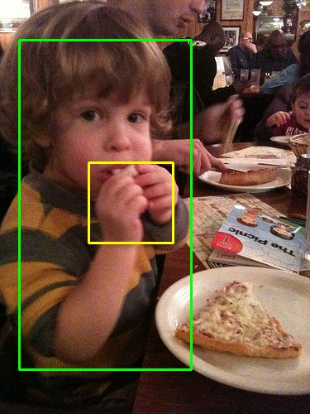
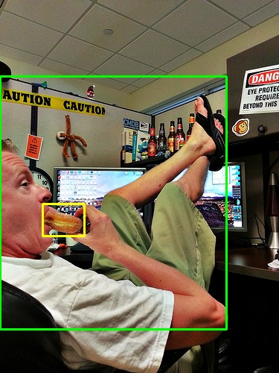
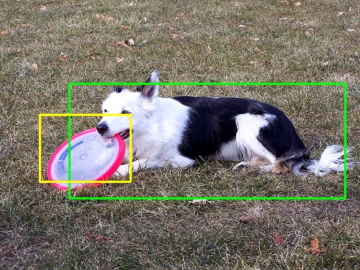
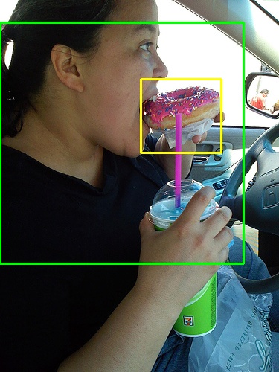
biting

Slide 38
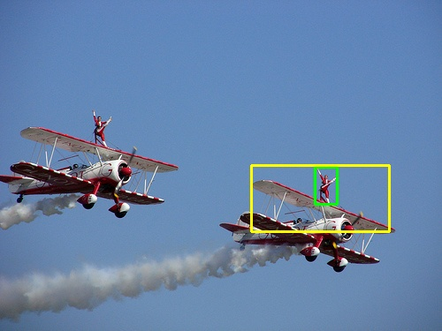
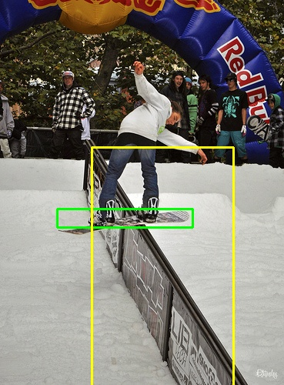
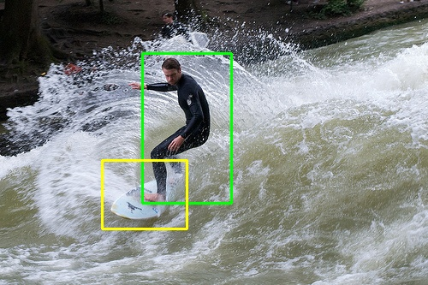
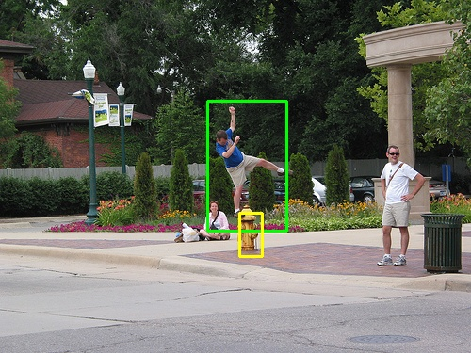
balancing on

Slide 39
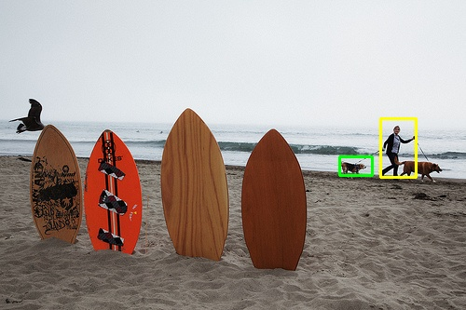
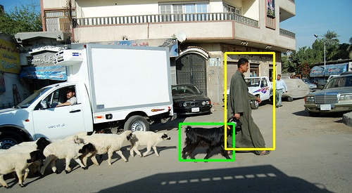
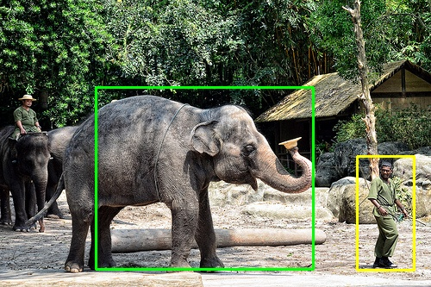
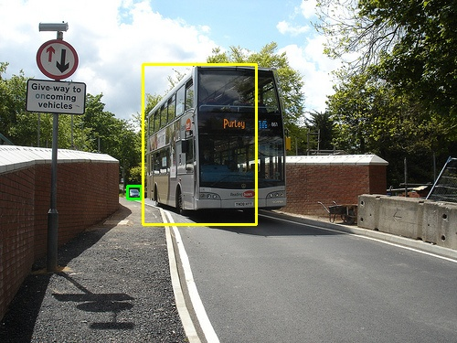
following

Slide 40
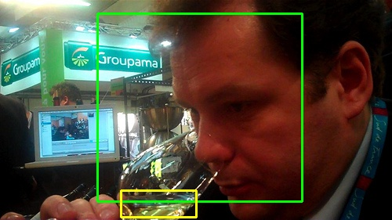
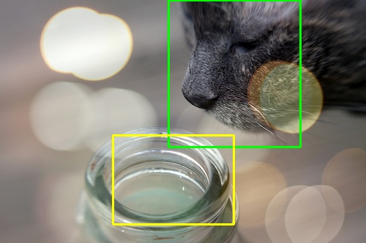
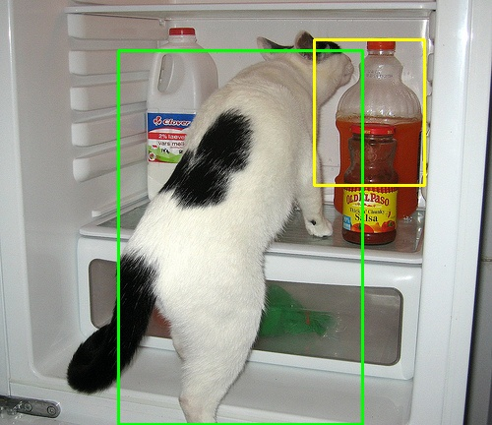
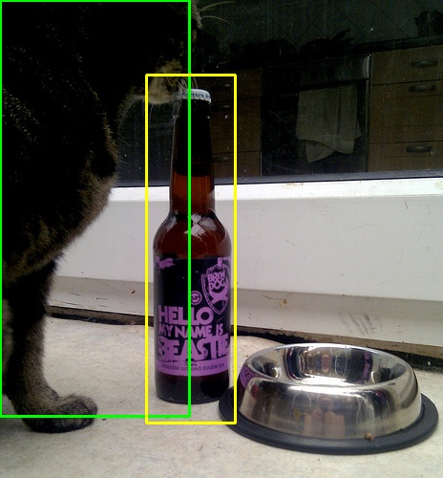
sniffing

Slide 41
Thank You
Any Questions?

